Slide 1
Week 2 – 5 Summary

Slide 2
help you visualise pointers and references
Compare the values and notice the difference
#include<iostream>
using namespace std;
int main() {
int a = 10, *b = &a, c = 42;
cout << " TEST 1" << endl;
cout << "&a: " << &a << endl;
cout << "a: " << a << endl;
cout << "b: " << b << endl;
cout << "*b: " << *b << endl;
cout << "&c: " << &c << endl;
cout << "c: " << c << endl;
a = 25;
cout << " TEST 2" << endl;
cout << "&a: " << &a << endl;
cout << "a: " << a << endl;
cout << "b: " << b << endl;
cout << "*b: " << *b << endl;
cout << "&c: " << &c << endl;
cout << "c: " << c << endl;
b = &c;
cout << " TEST 3" << endl;
cout << "&a: " << &a << endl;
cout << "a: " << a << endl;
cout << "b: " << b << endl;
cout << "*b: " << *b << endl;
cout << "&c: " << &c << endl;
cout << "c: " << c << endl;}
int a
int *b
“*” is used to declare a pointer
“&” is the address operator
“->” arrow operator
is similar to the “.” operator
except you use it for pointers

Slide 3
Namespace
The methods in the <iostream> library
are in the std namespace.
Normally you would use
std::cout << "not using namespace\n";
The line
using namespace std;
means we don’t have to add the std to the method call;
:: is the scope resolution operator
The scope operator is used to resolve which class a
particular member method belongs to. For example
void aclass::foo(arguments) {
// code }
Without the aclass:: the compiler wouldn’t know which class foo was associated with
The scope operator is also used to determine which namespace an object is associated with.

Slide 4
delete
#include <iostream>
using namespace std;
int main() {
int* ptra = new int;
int* ptrb = new int(42);
cout << "*ptra : " << *ptra << endl;
cout << "*ptrb : " << *ptrb << endl;
delete ptra;
delete ptrb;
cout << "*ptra : " << *ptra << endl;
cout << "*ptrb : " << *ptrb << endl;
ptra = nullptr;
ptrb = nullptr;
//if(ptra == nullptr)
// cout << "*ptra : nullptr" << endl; else
cout << "*ptra : " << *ptra << endl;
//if(ptrb == nullptr)
// cout << "*ptrb : nullptr" << endl; else
cout << "*ptrb : " << *ptrb << endl;
return 0; }
new tells the OS to allocate enough memory
and then return the starting address
which is put into a pointer
The delete keyword deletes the object that a pointer points to
It does not delete the pointer
!!!Once memory has been deleted it must never be used again other wise it will very likely crash the program.
To clear the pointer as well
Set it to null pointer

Slide 5
Templates
It essentially lets us use methods with any datatype
#include <iostream>
using namespace std;
template <typename T>
T myMax(T x, T y) {
//if(x > y) return x; else return y;}
return (x > y)? x: y; }
int main() {
cout << myMax<int>(10, 42) << endl;
cout << myMax<double>(0.0001, 101.01) << endl;
cout << myMax<char>('z', 'a') << endl;
return 0; }
Instead of variables being used parameters
Templates allows to pass datatypes as parameters
#include<iostream>
using namespace std;
template<class T, class U>
class A { T x; U y;
public: A() { cout << "Constructor called" << endl; } };
int main() {
A<char, char> a;
A<int, double> b;
return 0; }
There is no equivalent of templates in Java

Slide 6
Template for the Node class for a List
Node
prev
next
#ifndef DNODE_H
#define DNODE_H
template <typename dataType> struct dnode {
dataType data;
dnode *prev, *next;
// constructors
dnode() : prev(NULL), next(NULL) {}
dnode(const dataType& dataItem, dnode *prevPtr, dnode *nextPtr) : data(dataItem), prev(prevPtr), next(nextPtr) {} };
#endif
data
data

Slide 7
Sequence containers
Container adaptors
Base Standard
Array:
array<char,size> str;
Push()
Pop()
Stack: LIFO
stack<char> str;
Vector:
vector<char> str;
A deque is both
base standard and dynamic
Deque (double-ended-queue):
deque<char> str;
Queue: FIFO
queue<char> str;
Push()
Pop()
Dynamic
Forward List:
forward_list<char> str;
Push()
Priority Queue: Organised
priority_queue<char> str;
List:
list<char> str;
Pop()
Sequence container are “built from scratch”
Different data structure and algorithm time
Insert(), delete(), get()
Container adapter are
behaviours added on top of Sequence Container
Data is controlled by push(), pop()
Notes:
Vector uses more memory than Arrays
Deque are both Base Standard and Dynamic sequence containers
Nodes can be inserted in a linked list by playing around with the pointers
In an array, you need to copy and paste everything further down

Slide 8
class LinkedList {
public:
int length;
Node* head;
LinkedList();
~LinkedList();
void prepend(int data);
void append(int data);
void removeByValue(int data);
void removeByPosition(int position);
void insertByPosition(int position);
void ascendingSort();
void reverse();
void display(); };
LinkedList::LinkedList() {
this->length = 0;
this->head = NULL; }
Constructed
LinkedList
int length = 0;
head
OurStack
int length = 0;
head
NULL is an integer that can convert to pointer nullptr is only used for pointers, it cannot convert to an integer

Slide 9
LinkedList
void LinkedList::append(int data) {
Node* new_node = new Node();
new_node->data = data;
new_node->next = nullptr;
Node* ptr = this->head;
while(ptr->next){
ptr = ptr->next; }
ptr->next = new_node;
this->length++; }
int length = 3;
node
node
ptr
head
next
next
data
data
new_node
data
data
next
data
append()
data

Slide 10
LinkedList
void LinkedList::prepend(int data) {
Node* new_node = new Node();
new_node->data = data;
new_node->next = this->head;
this->head = new_node;
this->length++; }
int length = 3;
node
node
head
next
next
data
data
new_node
next
data
data
data
prepend()
data

Slide 11
#include <iostream>
using namespace std;
template <typename T, size_t S>
class stack {
private:
T data[S];
int length;
public:
stack(){ length = 0;}
~stack(){}
void push(T t){
if (length < S) data[length++] = t;
else cout << "Stack is full; Push failed!" << endl; }
T top(){ return data[length-1]; }
void pop(){ length--; }
bool empty(){ return length == 0; } };
http://www.cplusplus.com/reference/cstring/size_t/
Stacks
Notice Template and Size_t S
#include "stack.h"
int main(){
stack<int,10> s;
for (int i = 0; i < 12; i++) s.push(i);
while (!s.empty()){
cout << s.top() << endl;
s.pop();}}
Control mechanism
There is another way to do this
View next slide

Slide 12
OurStack
head
void OurStack::push(int data){
this->head = new Node(data, this->head);
this->length++;
cout << "Add " << data << endl; }
int length = 2;
push()
data
node
data
data
next
node
data
data
next

Slide 13
OurStack
void OurStack::pop(){
if(this->head != nullptr){
cout << "Remove " << this->head->data << endl;
this->head = this->head->next;
this->length-- ;
}
int length = 3;
head
node
data
data
next
node
data
data
next
node
data
data
next

Slide 14
Queues using stacks
This uses recursive algorithm
int pop() {
if (stack.empty()) {
cout << "Queue is empty";
exit(0); }
int data = stack.top();
stack.pop();
if (stack.empty()) return data;
int item = pop();
stack.push(data);
return item; } };
OurQueue
stack
head
node
data
data
node
data

Slide 15
#include <iostream>
using namespace std;
template <typename T>
class queue {
private:
T* data;
int capacity, head, length;
public:
queue(){
capacity = 10;
head = 0;
length = 0;
data = new T[capacity]; }
queue(int capacity){
this->capacity = capacity;
head = 0;
length = 0;
data = new T[capacity]; }
~queue(){
delete[] data; }
T front(){
return data[head]; }
void push(T t){
if (length >= capacity){
int newCapacity = capacity * 2;
T* newData = new T[newCapacity];
for (int i = 0 ; i < length; i++) newData[i] = data[(head + i)%capacity];
delete[] data;
data = newData;
capacity = newCapacity;
head = 0; }
data[(head+length)%capacity] = t;
length++; }
void pop(){
length--;
head = (head + 1) % capacity; }
void displayInfo(){
cout << "capacity = " << capacity << endl
<< "length = " << length << endl
<< "head_position = " << head << endl; }
bool empty(){ return length == 0; } };
Queues using array
If data[] is too small
create newData with greater capacity
Deep copy from data to newData
Delete data
Set data as new data

Slide 16
Destructors
The delete keyword deletes the object that a pointer points to
It does not delete the pointer
LinkedList::~LinkedList() {
while(this->head != nullptr){
Node* temp = this->head;
this->head = this->head->next;
delete temp; }
cout << "Linked list deleted!" << endl; }
OurStack::~OurStack(){
while(this->head != nullptr){
Node* temp = this->head;
this->head = this->head->next;
delete temp; } }

Slide 17
LinkedList
int length = 3;
node0
node2
Be careful how you delete
DO NOT BREAK THE SEQUENCE
For example,
In linked list deleting a node can break the chain
head
next
next
data
data
data
data
LinkedList::~LinkedList() {
while(this->head != nullptr){
Node* temp = this->head;
this->head = this->head->next;
delete temp; }
cout << "Linked list deleted!" << endl; }

Slide 18
LinkedList
Use a temp pointer
Skip the node to be deleted Then deleted the temp node
int length = 3;
temp
node0
node2
LinkedList::~LinkedList() {
while(this->head != nullptr){
Node* temp = this->head;
this->head = this->head->next;
delete temp; }
cout << "Linked list deleted!" << endl; }
head
next
next
data
data
node1
data
next
data
data
data

Slide 19
Interators
Iterators are used to point to a memory address for containers
#include <iostream>
#include <vector>
#include <list>
using namespace std;
int main() {
int ints[] = {10,9,8,7,6,5,4,3,2,1};
vector<int> intscontainer (ints, ints+10);
for (vector<int>::iterator i=intscontainer.begin();
i!=intscontainer.end();
++i)
cout << *i << ' ' << endl;
cout << "Happy New Year";
return 0; }

Slide 20
public, protected and private mean when inheriting
The default for C++ is 'private’
#include<iostream>
using namespace std;
class A {
public: int x;
protected: int y;
private: int z;
public: A(int x, int y, int z) {
this->x=x;
this->y=y;
this->z=z; }
public: void print() {
cout<< "public A->x:" << this->x <<endl;
cout<< "protected A->y:" << this->y <<endl;
cout<< "private A->z:" << this->z <<endl; } };
class B : public A {
// x is public, y is protected, z is not accessible from B
public: B(int x, int y, int z):A(x,y,z){}; };
class C : protected A {
// x is protected, y is protected, z is not accessible from C
public: C(int x, int y, int z):A(x,y,z){}; };
class D : private A {
// x is private, y is private, z is not accessible from D
public: D(int x, int y, int z):A(x,y,z){}; };
int main() {
A* test = new A(7,8,9);
test->print();
//cout<< "test->x:" << test->x <<endl;
//cout<< "test->y:" << test->y <<endl;
//cout<< "test->z:" << test->z <<endl;
return 0; }

Slide 21
Try and Catch example with what()
#include <iostream>
#include <exception>
using namespace std;
class myexception: public exception {
virtual const char* what() const throw() {
return "My exception happened"; }
} myex;
int main() {
try {
throw myex; }
catch (exception &e) {
cerr << e.what() << "\n"; }
return 0; }

Slide 22
Program to copy text from one file to another
#include <string>
#include <iostream>
#include <fstream>
using namespace std;
void getFiles(string &filein, string &fileout);
void copyFile(const string &filein, const string fileout);
int main() {
string filein, fileout;
getFiles(filein, fileout);
copyFile(filein, fileout);
return 0; }
void getFiles(string &filein, string &fileout) {
cout << "Please enter file to copy :";
cin >> filein;
cout << "Please enter target file :";
cin >> fileout; }
void copyFile(const string &filein, const string &fileout) {
ifstream fin; ofstream fout; char ch;
fin.open(filein.c_str());
if (!fin) {
cerr << "Can't open " << filein << " \n";
exit(1); }
fout.open(fileout.c_str());
if (!fout) {
cerr << "Can't open " << fileout << " \n";
fin.close();
exit(1); }
while (!fin.eof()) {
fin.get(ch);
fout.put(ch); }
fin.close();
fout.close(); }
while not end of file
“const” in C++ is like “final” in Java
!!! remember to close your streams

Slide 23
#include <iostream>
using namespace std;
template <typename T>
T linearbinarysearch(T bin[], T left, T right, T find) {
while (left <= right) {
T mid = left + (right - left) / 2;
if (bin[mid] == find){
return mid;
}else if (bin[mid] < find){
left = mid + 1;
}else
right = mid - 1; }
return -1; }
template <typename T>
T recursivebinarysearch(T bin[], T left, T right, T find) {
if (right >= left) {
T mid = left + (right - left) / 2;
if (bin[mid] == find){
return mid;
}else if (bin[mid] > find){
return recursivebinarysearch(bin, left, mid - 1, find);
}else{
return recursivebinarysearch(bin, mid + 1, right, find); } }
return -1; }
Binary Search the code
int main() {
long bin[] = {0,1,2, 4, 8,16,32,64,128,256};
long find = 32;
long length = sizeof(bin) / sizeof(*bin);
cout << find << " is at " <<
linearbinarysearch<long>(bin, 0, length-1, find) << " position of bin[]" << endl;
cout << find << " is at " <<
recursivebinarysearch<long>(bin, 0, length-1, find) << " position of bin[]" << endl;
cout << "The value at bin[" << linearbinarysearch<long>(bin, 0, length-1, find)
<< "] is " << bin[linearbinarysearch<long>(bin, 0, length-1, find)] << endl;
cout << "The value at bin[" << recursivebinarysearch<long>(bin, 0, length-1, find)
<< "] is " << bin[recursivebinarysearch<long>(bin, 0, length-1, find)] << endl;}
Recursive is elegant but it can use up processing power

Slide 24
Big O using the Fibonacci algorithm
Linear
uses 5 variable
and 1 for loop
Linear will run faster
O(n)
Recursive
uses 1 variable
O(2^n)
#include<iostream>
using namespace std;
int fib(int n) {
int a = 0, b = 1, c, i;
if( n == 0) return a;
for (i = 2; i <= n; i++) {
c = a + b;
a = b;
b = c; }
return b; }
int main () {
int n = 75;
cout << fib(n);
return 0; }
#include<iostream>
using namespace std;
int fib(int n) {
if (n <= 1) return n;
return fib(n-1) + fib(n-2); }
int main () {
int n = 45;
cout << fib(n);
return 0; }
Remain efficient and effective with memory usage
big O is meant to consider the worst case where the variable approaches infinity
The order of any expression can be determined by
keeping the dominant term within the expression.
Notes:
Solution here (resize notes to be one line)
Fibonacci Linear is O(n) because of the for loop
Fibonacci Recursion is Fib(n) = Fib(n-1)+Fib(n-2);
Fib(n) = O(2^n-1)+0(2^n-2) = O(2^n);

Slide 25
O() | Name | Phone book
1 | Constant | Given the page that a business's name is on and the business name, find the phone number. Given the page that a person's name is on and their name, find the phone number.
Log n | Logarithmic | Given a person's name, find the phone number by picking a random point about halfway through the part of the book you haven't searched yet, then checking to see whether the person's name is at that point. Then repeat the process about halfway through the part of the book where the person's name lies. (This is a binary search for a person's name.)
n | Linear | Find all people whose phone numbers contain the digit "5". Given a phone number, find the person or business with that number.
n log n | Log Linear | There was a mix-up at the printer's office, and our phone book had all its pages inserted in a random order. Fix the ordering so that it's correct by looking at the first name on each page and then putting that page in the appropriate spot in a new, empty phone book. We want to personalize the phone book, so we're going to find each person or business's name in their designated copy, then circle their name in the book and write a short thank-you note for their patronage.
n² | Quadratic | A mistake occurred at the office, and every entry in each of the phone books has an extra "0" at the end of the phone number. Take some white-out and remove each zero.
2^n 2^{n} | Exponential | We have been through the Fibonacci example
n! | Factorial | We're ready to load the phonebooks onto the shipping dock. Unfortunately, the robot that was supposed to load the books has gone haywire: it's putting the books onto the truck in a random order! Even worse, it loads all the books onto the truck, then checks to see if they're in the right order, and if not, it unloads them and starts over.

Slide 26
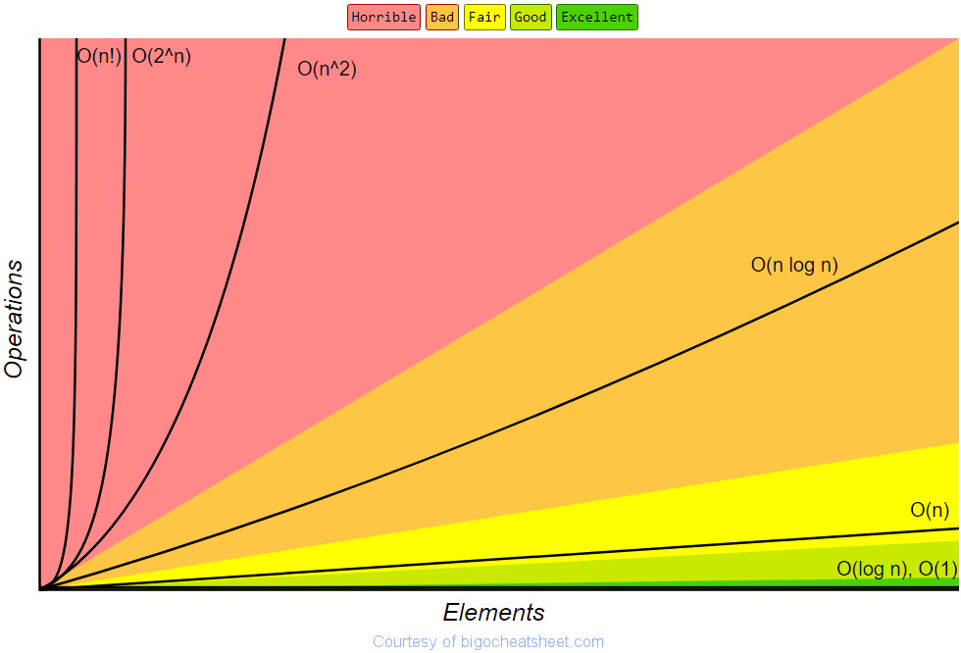
Notice these
https://www.bigocheatsheet.com/

Slide 27
.cpp and .h files
Abstract method methods MUST BE overridden
Virtual methods can be overridden
“virtual void method() = 0;” means that it has nothing (it is purely virtual)
Place the declarations in the .h file
in between #ifndef #define and #endif
place the code in the .cpp file
#include <iostream>
#include "linkedList.h"
using namespace std;
LinkedList::Node::Node(int data, Node * next){
this->data = data;
this->next = next;
}
LinkedList::Node::~Node() {
}
LinkedList::LinkedList(){
this->head = nullptr;
}
…
#ifndef LINKEDLIST_H_
#define LINKEDLIST_H_
class LinkedList : public BaseList {
private:
class Node {
public:
int data; Node * next;
Node(int data, Node * next);
~Node(); };
Node * head;
public:
LinkedList();
~LinkedList();
void prepend(int data);
void append(int data);
void display(); };
#endif

Slide 28
C++ resources
http://www.cplusplus.com/reference/
https://stackoverflow.com/
https://www.geeksforgeeks.org/
…
Google is your friend

